Slide 1
The concept of symmetry and the theory of problem solving
Zyg Pizlo
UC Irvine

Slide 2
Combinatorial Optimization Problems

Slide 3
Traveling Salesman Problem:
Find the shortest tour of N cities.

Slide 4
Traveling Salesman Problem:
Number of tours is (N-1)!/2
TSP belongs to a class of difficult (computationally intractable) problems.

Slide 5
Traveling Salesman Problem
Find the shortest tour of N cities.
This is a combinatorial optimization problem with a very large search space.
Number of all tours (N-1)!/2
The search space increases as an exponential function of N.
Exponentially growing search space is a sign of a difficult problem.
Note that exponential function grows faster with N than any polynomial function.

Slide 6
Number of tours in “small” TSP problems
6-city: 60
10-city: 181,440.
16-city: 10¹¹ – the number of neurons in the brain
21-city: 10¹⁸ – the number of seconds since the Big Bang
61-city: 10⁸¹ – the number of atoms in the Universe
82-city: 10¹²⁰ – the number of states in chess

Slide 7
Human TSP performance
Subjects are typically tested in TSP with fewer than 100 cities.

Slide 8
20-city TSP is usually solved by subjects in less than 1 minute. Forget the number of seconds since the Big Bang…

Slide 11
How do humans do it? The role of clustering.
If one begins in Paris, and sets out to visit several places in France, Germany, Hungary and Italy before going back to Paris, it is obvious that in order to minimize the total travel length, the places in France should be visited one after another before going to Germany, then Hungary and finally to Italy. The decision about the order in which the four countries are visited is made first and it should be the one just mentioned, or its reverse, namely, Italy, Hungary, Germany and back to France.

Slide 12
The role of clustering
It is fairly obvious that going from France to Hungary, Germany, Italy, and back to France is sub optimal, regardless of the order in which the places within each country are visited. The quality of the global aspects of the tour are unaffected by its local aspects. If the global tour is optimal, local errors will not be able to make the overall tour very much longer than the optimal one. And conversely, if there is an error in the global tour, the overall tour length will be highly suboptimal, regardless of the optimality of its local parts.

Slide 13
Human Visual System as a Multiscale Pyramid
The bottom layer represents the retinal or the camera image. In the human retina there is one million of ganglion cells that provide input for most visual functions such as pattern and object perception, reading, color, motion, and depth. The second layer in the pyramid contains parent cells (nodes), each parent receiving input from four child cells. The third layer is the grandparent layer and the spatial relation between grandparent and parent cells is the same as between parent and children cells. This repeats until there is only one cell at the top of the pyramid. The cells in the pyramid function simultaneously and independently. This makes pyramid architecture a version of a parallel computer.

Slide 14
Pyramid model
Top-down (coarse-to-fine) tour refinements: 50-city TSP
Human subjects never store the entire problem in their working memory.
Can we model this?
The visual input of the model is a 6x6 pixel array (camera). The camera can zoom-in or zoom-out.
The algorithm is detecting 2-5 clusters at a given scale. The algorithm does not have to store the entire TSP problem in memory – the algorithm has the TSP problem in front of its camera.
Animations (http://bigbird.socsci.uci.edu/research.html):
TSP – demo2
TSP – demo3
TSP – demo4

Slide 15
Pyramid architecture is self-similar
Clustering operations use the same rules in all places across the image and at all levels of the pyramid.
The distribution of TSP cities is not necessarily symmetrical, but pyramid operations are symmetrical (self-similar).
The global-to-local tour refinement in the pyramid leads to self-similar tours.
  Self-similarity represents fractal symmetry.
A multiscale/multiresolution pyramid is the only way to account for human performance: linear-time complexity and near optimal tours.
The pyramid model produces near-optimal tours very quickly.
  Optimally solving a problem is not the same as solving a problem optimally.

Slide 16
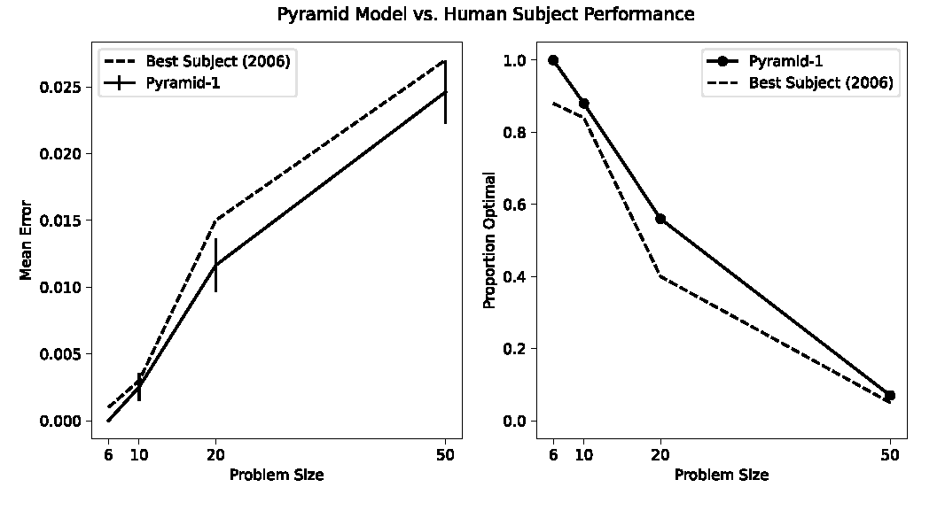
VanDrunen et al. (2022)
https://github.com/jackvandrunen/tsp

Slide 17
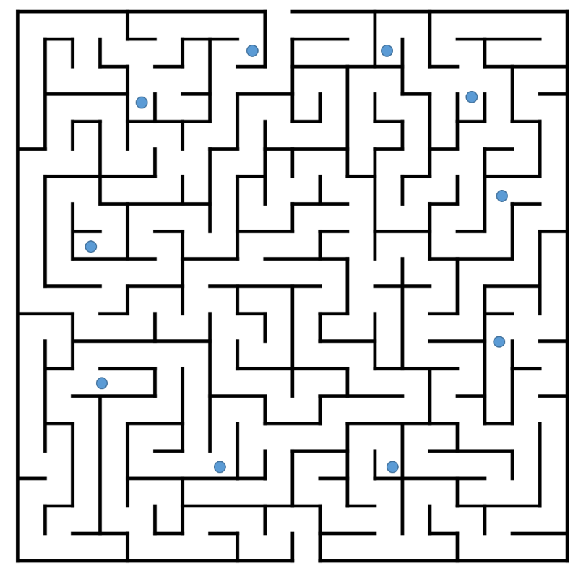
TSP where hierarchical clustering will not work
The model cannot solve this and neither can the subjects.

Slide 18
Insight in problem solving
Research on human problem solving started with insight problems (Köhler, 1917).
There haven’t been many empirical data on insight problems.
  It is hard to study insight problem solving.
There have been no theoretical formalisms.
  Gestalt Psychologists pointed out that changing mental representation is a key.
  What did they mean?

Slide 19
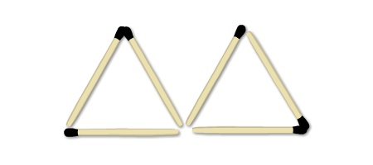
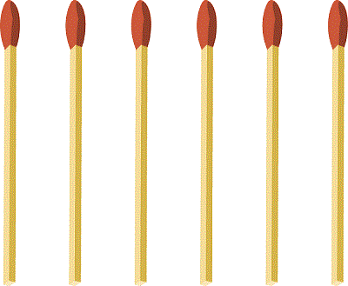
Construct 4 equilateral triangles
Using 6 matchsticks

Slide 20
Insight requires changing the problem representation
When you start solving an insight problem, you probably begin with an inadequate representation. You are stuck.
Getting an insight (AHA, Eureka!) follows switching to a new, better representation.

Slide 21
2D plane is a wrong representation for our triangles problem!

Slide 22
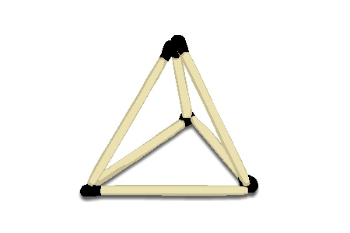
3D space is the correct representation!
You can produce more symmetries among the 4 triangles in 3D, as compared to 2D.
The problem is difficult to solve, but easy to verify the correct solution…

Slide 23
Walking up and down the hill
Assume that at 9am you started walking uphill on a mountain trail. It took you several hours to get to the top of the mountain. The speed of your walking was not constant. You stayed overnight at a hotel on the top of the mountain and the next morning, at 9am, you started walking down the hill using exactly the same trail. Walking downhill was easier and faster. But you wondered whether there was a place on the trail that you passed today at exactly the same time as yesterday when you walked uphill.

Slide 24

Walking up and down the hill
distance
time
9am

Slide 25
Walking up and down the hill
Instead of one person walking on two different days, think about two people walking on the same day.
The trajectory of walking (s(t)) is invariant to the translation of the origin of the time axis.
Done!
distance
time
9am

Slide 26
Insight problems
Very difficult to solve, but very easy to verify the correct solution (or to explain the solution to someone else).
This is an informal definition of the class of NP-complete problems.
  So far, no one connected NP-completeness with human problem solving (check my 2022 book).

Slide 27
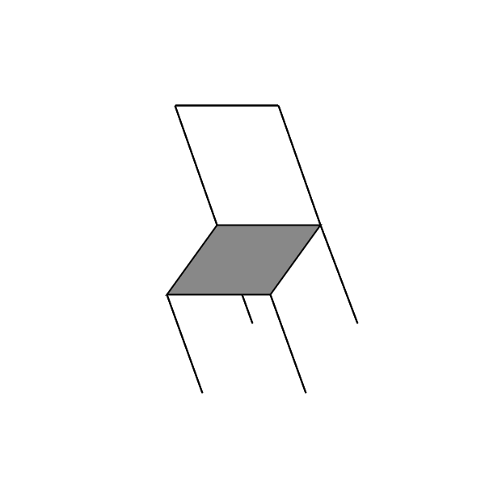
The visual system changes the representation all the time.
When you look at a 2D image of a 3D object, you see a 3D object.
  3D vision is an ill-posed problem.
In my model of 3D vision, the 3D representation is produced by using 3D symmetry as the main constraint (aka prior) in 3D shape recovery.
The 2D representation on the retinal image is inadequate: it is 2D and not symmetrical. A human agent must have access to the 3D permanent characteristics of physical objects (shape, size, reflectance…) in order to plan and execute actions in the 3D physical environment.

Slide 28
The visual system solves this insight problem for you
Human 3D vision is all about changing representation from 2D to 3D.
2D representation is not adequate because the physical world is 3D, not 2D.
  2D data is an image, not a physical environment.
So, human 3D vision is like solving insight problems. The problems are computationally difficult, but our visual system solves them effortlessly and perfectly (or nearly so).
  The visual system discovered how to solve this insight problem during the evolution.

Slide 29
Symmetry in the theories of Physics
Physicists today realize that symmetry is of fundamental importance in Physics, but this realization (insight) did not happen until about 100 years ago. This change of attitude towards symmetry can be attributed to Albert Einstein (1905) and Emmy Noether (1918).
Example of symmetry of the Natural Law: Imagine performing an experiment (dropping an object) in a corner of your room and then repeating this experiment in another corner of your room. The results of these two experiments will be identical, except for some measurement error. Such invariance of physical laws under spatial translations is called the symmetry of the laws under spatial translation. You may also decide to repeat this experiment on the next day. Again, you will discover that the Natural Laws are symmetrical under time translation.
Symmetry of the Natural Laws leads to Conservation Laws.

Slide 30
Scientific discovery is a form of an insight
If it is true that some of the deepest characteristics of Physics can be attributed to, or derived from symmetry, it is not surprising that scientific discovery (scientific insight) is often related to discovering symmetry.
What I am suggesting is that discovering symmetry could be the basis of insight problem solving with ordinary brain teasers.
  Somehow, both AI and Cognitive communities ignored the importance of the Laws of Physics and the mathematical formalism of symmetry, which rules all Physics.

Slide 31
Covering 8x8 array with 2x1 domino pieces
Trivial task

Slide 32
How about now?
Not easy…
Look for symmetry…

Slide 33
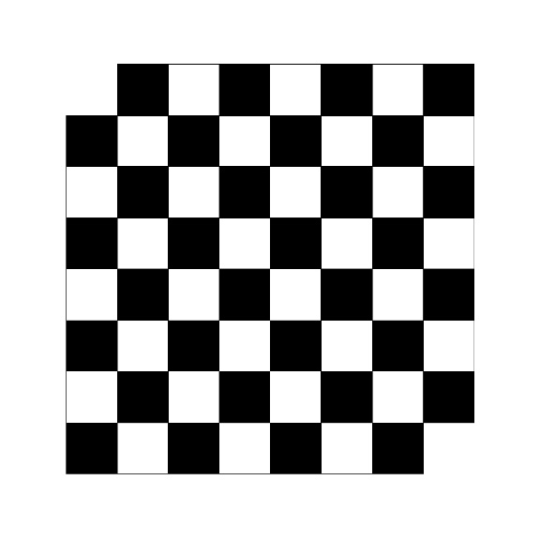
Mutilated checkerboard
The parity is the key…

Slide 34
Analogy is a form of symmetry
Polya (1945): consider two ships each moving with a constant speed, V₁ and V₂, respectively, along the straight-line trajectories. Given their starting points, compute the shortest distance between them.
The problem is difficult; can you think of a similar, but simpler problem that is easier?
Similarity is analogy: both are forms of symmetry.

Slide 35
V₁
V₂

Slide 36
The problem would be much easier if V₂=0
The answer is the distance of V₂ from line V₁.
V₁
V₂

Slide 37
We can transform the difficult problem by adopting a different coordinate system
Imagine that I carry the sheet of paper on which the two ships move. I can decide to walk in the room along a straight line with velocity –V₂. The problem and solution will not change in the room coordinate system.
I cancel the movement of one of the ships (ship 2) in the room coordinate system.

Slide 38
Now our problem is easy!
The answer is the distance of a point from a line.
Remember that we used a similar trick, but in the opposite direction in the problem of walking up and down a hill.
V₁
-V₂
V₂

Slide 39
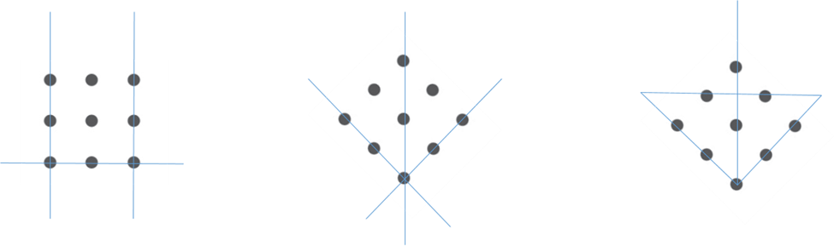

9 dots – connect them with 4 straight lines without lifting your pen

Slide 40
We already saw a few insight problems
For humans, vertical/horizontal symmetries are more salient than oblique ones. So, I rotated the pattern by 45deg to produce a diamond shape

Slide 42
Scientific Discovery
It is so rare and so transformational, then we can safely consider it the most sophisticated version of an insight.
Next a few examples of scientific discovery on physics.

Slide 43
Comparing volumes of two objects
The problem Archimedes was trying to solve was verifying whether the crown was made of pure gold, or whether some gold was replaced by silver. Silver is less dense than gold, so a mixture of silver and gold would have a slightly greater volume than a piece of pure gold of the same weight. Archimedes solved this problem by examining the invariance of a balance with the crown suspended from one arm of the balance and a piece pure gold of identical weight suspended from the other arm, when this system was translated from one physical medium (air) to another (water).

Slide 44
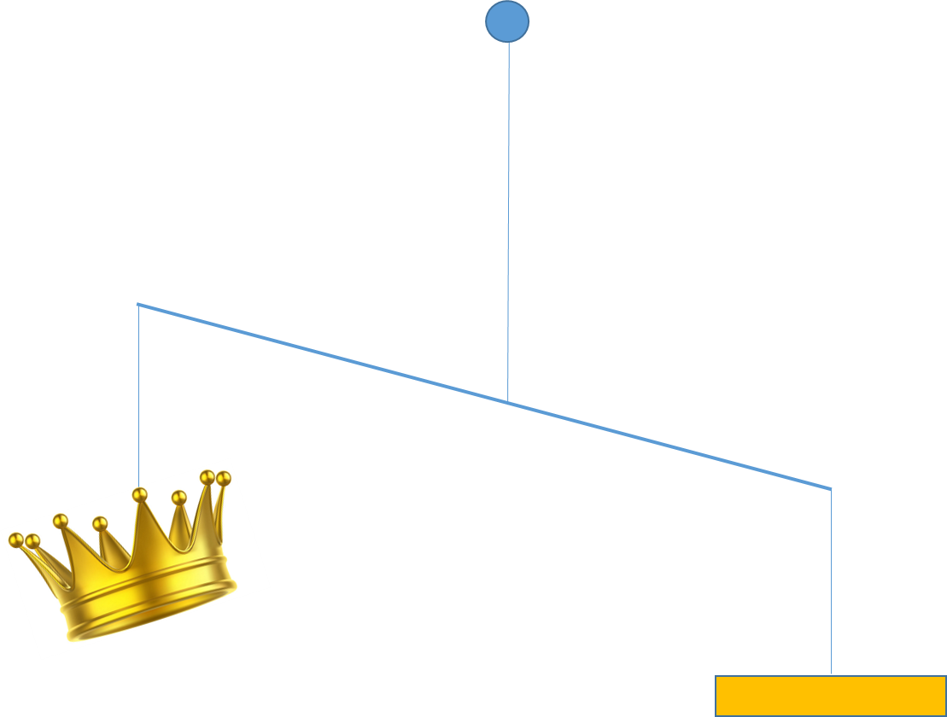
Archimedes’s discovery
Eureka!

Slide 45
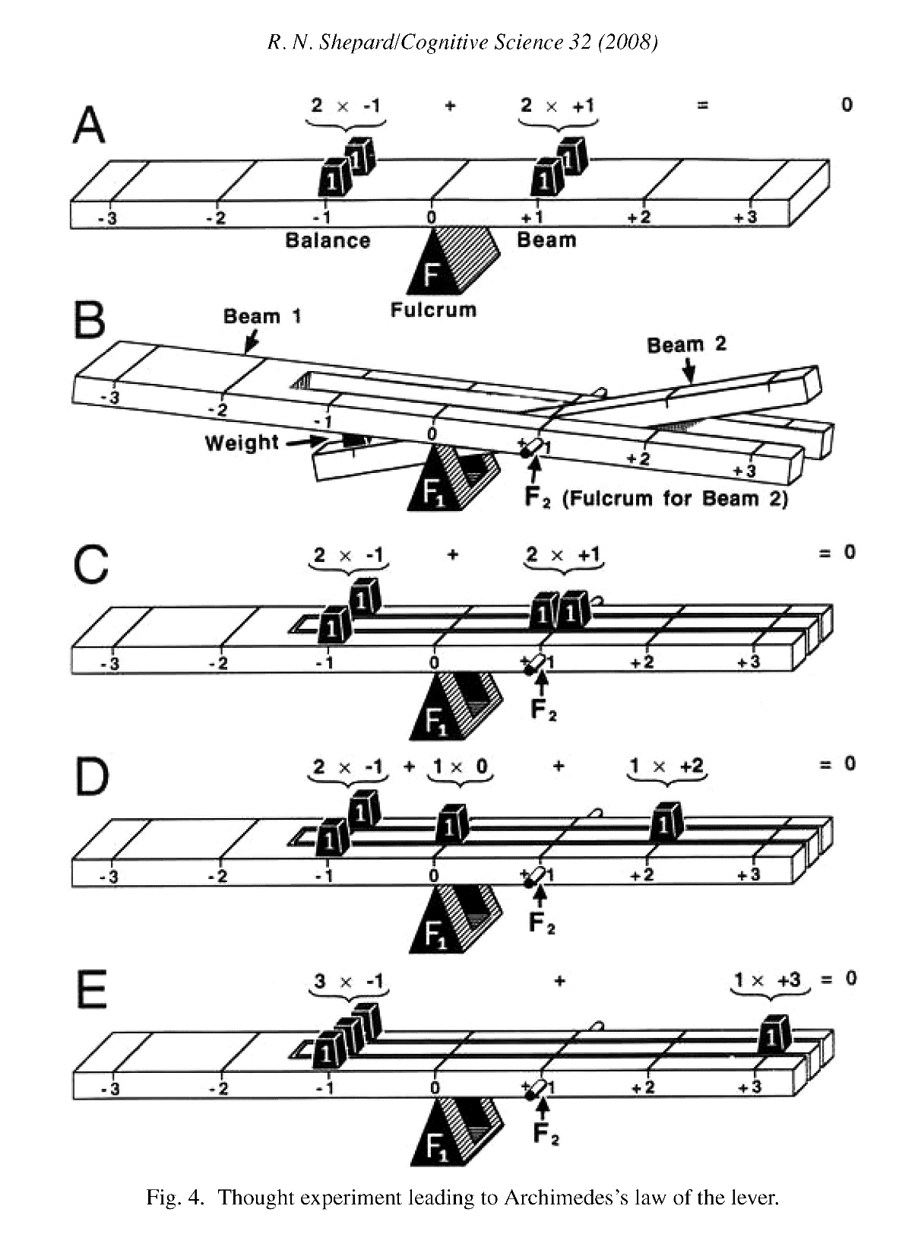
Lever principle: Archimedes
From Shepard (2008)

Slide 46
Galileo’s Law of Free Fall
Before Galileo, it was commonly assumed that heavier bodies fall faster under the influence of gravity.
Consider three identical bricks. All three must fall with the same acceleration simply because the bricks are identical. A mathematician would refer to this identity as a permutation symmetry (invariance). Now, imagine that we glue two of these bricks (or connect them by using a string). Once this has been done the two bricks are twice as heavy as a single brick. When we drop our bricks, there are still 3 identical bricks falling down. There is simply no reason why the two connected bricks should fall faster than the third brick.
We don’t need an experiment in this case, either. Symmetry inherent in the problem provides the solution.
  If an experiment rejected Galileo’s law, we would have to conclude that the experiment was flawed. Popper’s falsification desideratum has limited application, after all.

Slide 47
Einstein's special relativity theory
By 1905 it was known that there was no experiment in physics that could inform an experimenter about whether her frame of reference was stationary or was moving with a constant speed. When you are in your home and you throw an object straight up in the air, you know that this object will fall down to your hand. This is obvious when you are stationary because the only component of velocity of the object is vertical. But if you repeat this experiment while sitting on a train that is moving with a constant speed, the result of your experiment would be exactly the same, namely, the object’s trajectory in the reference frame of the train would be identical to the one you had at home. As a result, only observing the motion of the object relative to yourself will tell you absolutely nothing about whether you are moving or stationary. The same was assumed to be true about all other experiments in Physics except for the speed of light.

Slide 48
Einstein's special relativity theory
It seemed obvious to Einstein that the speed of light should not be an exception to the universal invariance (symmetry) of the Laws of Physics to the uniform motion of the experimenter.
Einstein added the invariance of the speed of light.

Slide 49
One more brain teaser

Slide 50
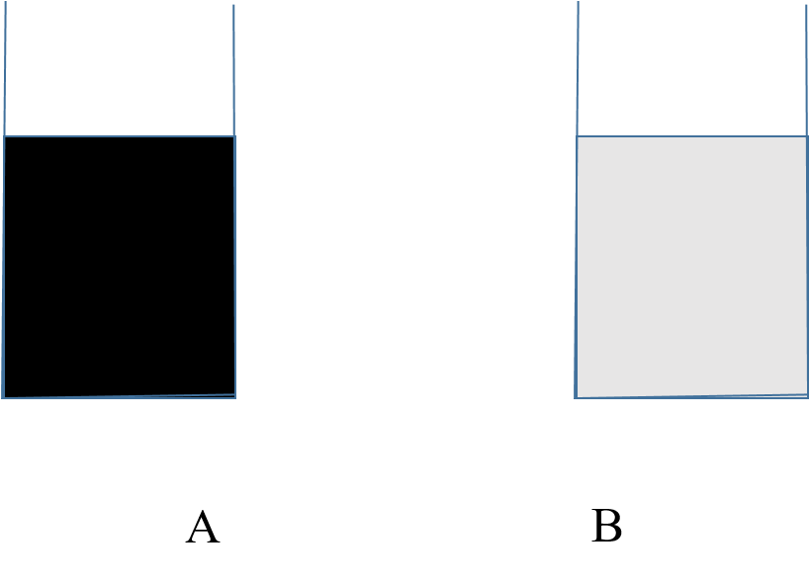
I have two containers, A filled with a liter of coffee and B with a liter of cream. I take a cup, say a measuring glass, and: (i) fill it up with coffee from A and pour it into B, mix it thoroughly, and: (ii) return a cup filled with the mixture to A and then mix it up. Now both containers have a liter of liquid in them. Is there more cream in A than coffee in B? Forget any chemistry and assume the mixtures mix easily and without any loss of volume.
A “brute force” approach, which uses equations for concentration of solutions, will produce the answer, if you don’t get confused when you write the formulas down (try this as an exercise, to find out).
A much simpler and intuitive solution is dictated by symmetry. We started with equal volumes in A and B and we ended up with equal volumes. This symmetry implies that the amount of cream added to A is the same as the amount of coffee added to B. AHA!

Slide 51
Conclusions
Insight refers to discovering symmetries in the problem representation – this includes formulating new theories in science.
In TSP, the visual system discovered, during the evolution, that imposing fractal symmetry on the representation of a combinatorial optimization problem leads to good solutions.
In 3D vision, the visual system discovered, during the evolution, that 3D mirror symmetry is ubiquitous in the natural environment and should be used as a constraint (prior) in 3D perception.
Symmetry is at the very foundation of math and physics.
It is encouraging to realize that Cognitive mechanisms (perception and problem solving) can also be explained by using symmetry.

Slide 52
